Slide 1
Thesis Plan
Separating Cyslostationary Signals using the Nonlinear Dynamics of Continuous-Time Recurrent Neural Networks

Slide 2
Motivation
Current machine learning paradigms don’t resemble the brain
Reservoir computing methods, especially Liquid State Machines, provide a biologically plausible computational framework
This work will investigate the liquid state machine framework with an emphasis on the nonlinear delay dynamics that arise from realistic distributions of synapse lengths and signal propagation times
The work will focus on recognizing stationary and cyclostationary time series

Slide 3
Stationary and cyclostationary signals
Stationary signals have constant statistical properties over time
Cyclostationary signals have statistical properties that vary cyclicly over time
Autocorrelation function is periodic
Leads to cyclic autocorrelation function and cycle frequencies
Periodic and PPM spike train plots

Slide 4
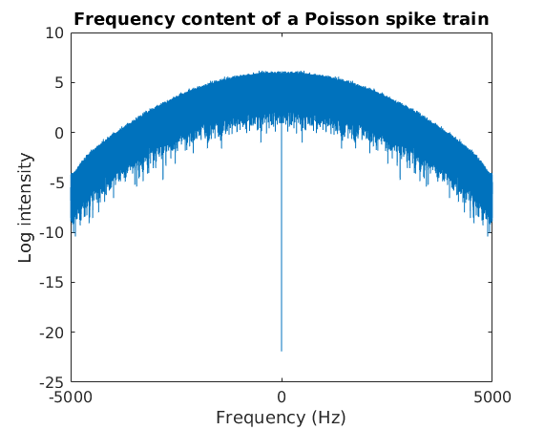
Poisson spike trains
Average firing rate R with Poisson statistics
No frequency content visible at R
Gaussian spikes
De-meaned data
Mean ISI = 0.052 (R=20 Hz)
Std of ISI = 0.055

Slide 5
Reservoir Computing
Nonlinear reservoir with fading memory is driven by an input
The input evokes complex dynamics in the reservoir
A linear readout map extracts the desired data from the reservoir
Multiple readouts can be trained with simple regression to extract different information from the same reservoir
Separated into machine learning (Echo State Machines) and biologically plausible neural dynamics (Liquid State Machines)

Slide 6
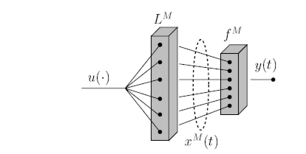
Liquid State Machines
The reservoir can be viewed as a nonlinear filter L^{M} that transforms an input u into an M-dimensional state vector x^{M}
Multiple readout functions f^{M} then map the state vector onto the desired output y
“Real-Time Computing Without Stable States: A New Framework for Neural Computation Based on Perturbations”, W. Maas, T. Natschlager, H. Markram

Slide 7
Fidelity spectrum of neural models
Simplified computational models
High-fidelity biological models
Increasing dynamic fidelity, increasing computational requirements
Perceptron:
Weighted sum of input values
No dynamic behavior
Not spiking
Izhikevich:
Two coupled differential equations
Four parameters
Replicates observed spiking patterns
Hodgkins-Huxley:
Four coupled differential equations
>10 parameters
Corresponds to known ion channels
This work lives here, numerical integration in MATLAB and NEURON

Slide 8
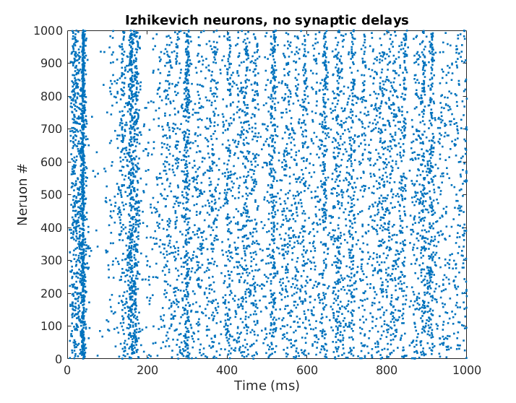
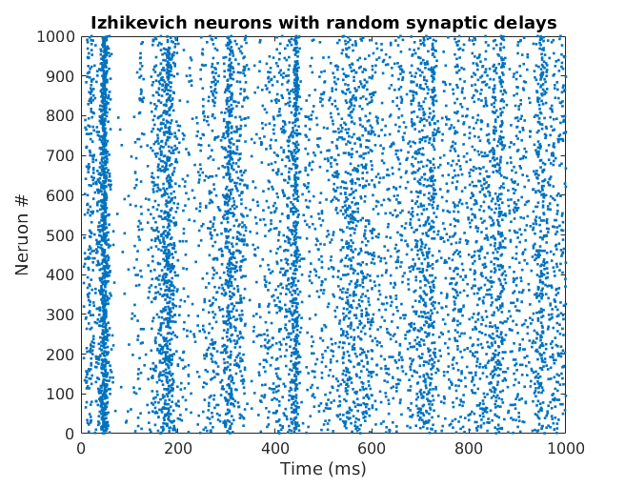
Initial model: Izhikevich
Classic Izhikevich (2003)
With random synaptic delays 0-4 ms

Slide 9
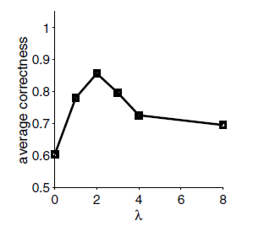
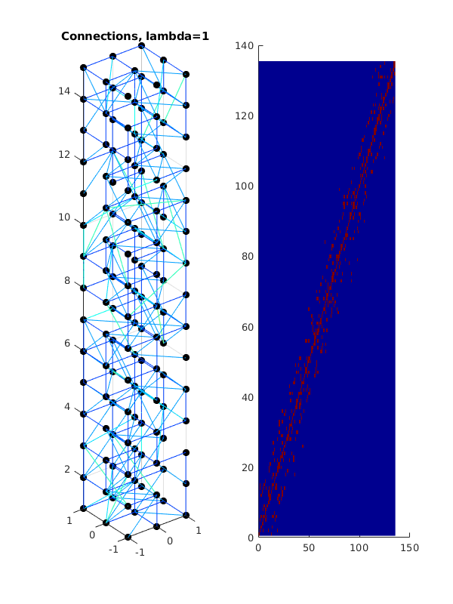
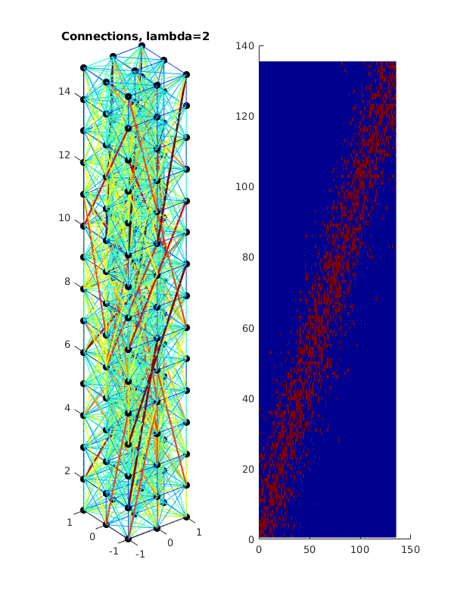
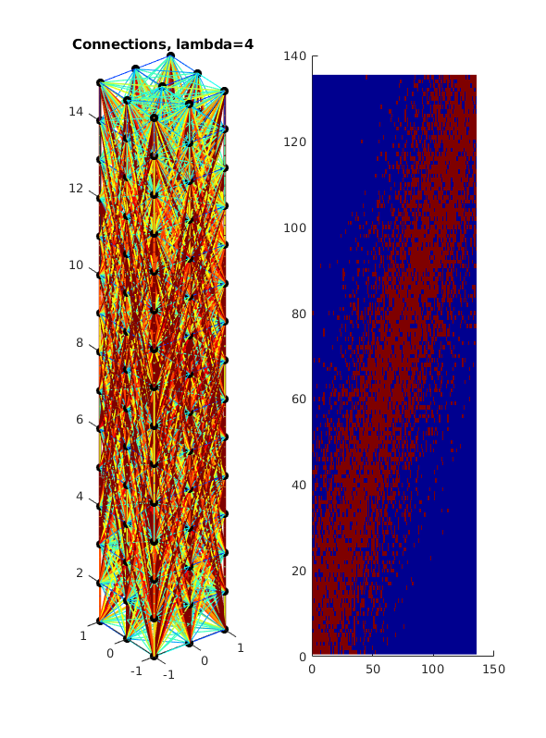
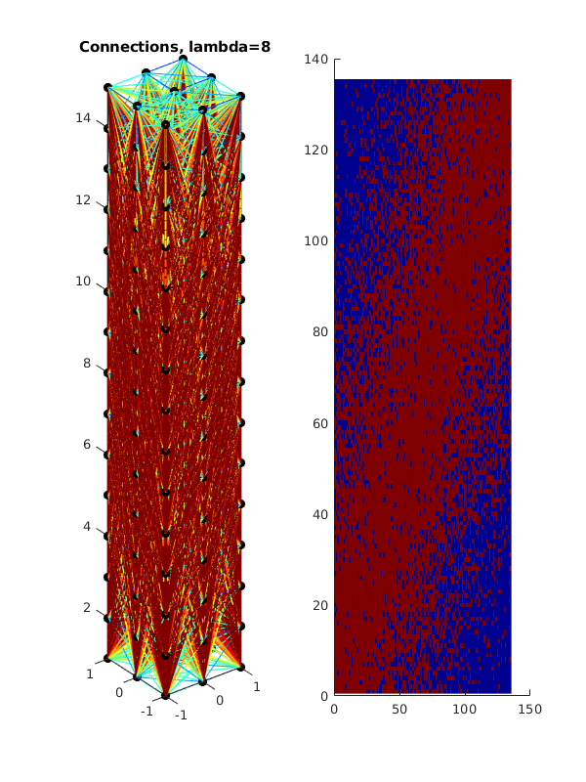
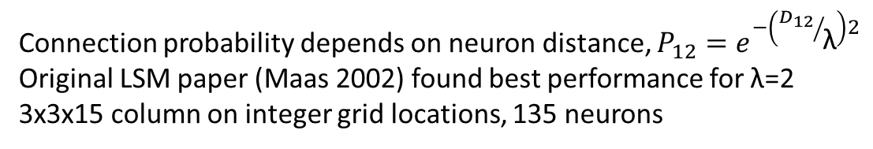
Neural connectivity
Connection probability depends on neuron distance, $P_{12}=e^{−\left({D_{12}}/{\text{λ}}\right)2}$
Original LSM paper (Maas 2002) found best performance for λ=2
3x3x15 column on integer grid locations, 135 neurons

